Slide 1



Name of Project
Autonomous Control System for Electric Vehicles
-presented by
Mangali Ashwitha

Slide 2

Learning Objectives
To understand the concept of behavioral cloning and how it helps in achieving autonomous vehicle control.
To learn how deep learning models, especially convolutional neural networks, can be used for predicting steering angles based on camera input.
To explore the process of data collection and preprocessing from driving simulators for model training.
To implement an autonomous driving system that can take real-time input and generate control outputs such as steering and throttle.
To gain practical knowledge in Flask and Socket IO for real-time communication between the simulator and our trained model.
To analyze the performance of the system and understand how it can be adapted for electric vehicles in the real world.
GOAL
Source :
www.freepik.com/

Slide 3
Tools and Technology used
Python for programming.
Keras and TensorFlow for building and training the deep learning model.
Flask and SocketIO for real-time communication between the simulator and our model.
OpenCV and NumPy for image preprocessing and numerical operations.
Udacity Simulator to collect data and test the autonomous driving system.

Slide 4
Methodology
Data Collection:
We collected driving images and telemetry data from the simulator.
Data Preprocessing:
The images were cropped, resized, converted to YUV color space, and normalized for better model performance.
Model Training:
A Convolutional Neural Network (CNN) was trained to predict steering angles based on processed images.
Model Testing:
The trained model was tested in the simulator to evaluate real-time performance.
Deployment:
Using Flask and SocketIO, the model was connected to the simulator for real-time steering and throttle control.

Slide 5
Problem Statement:
Modern transportation faces significant challenges such as road accidents due to human error, inefficient energy usage, and traffic congestion. Electric Vehicles (EVs), while offering an eco-friendly solution, still depend on human input for safe and efficient navigation. To achieve true intelligent mobility, there is a need for an autonomous driving system capable of perceiving, learning, and making real-time driving decisions.

Slide 6
Solution:
“To address these challenges, we propose an Autonomous Control System for Electric Vehicles.
Our system uses a deep learning–based behavioral cloning model that learns from human driving data.
It processes real-time camera input to predict the correct steering angle and throttle for safe driving.
Using Flask and SocketIO, the trained model communicates with the simulator to control the vehicle automatically.
This allows the electric vehicle to navigate smoothly, avoid human errors, and drive efficiently without manual input.
In short, our solution enables intelligent, self-driving capability for electric vehicles using AI.”

Slide 7
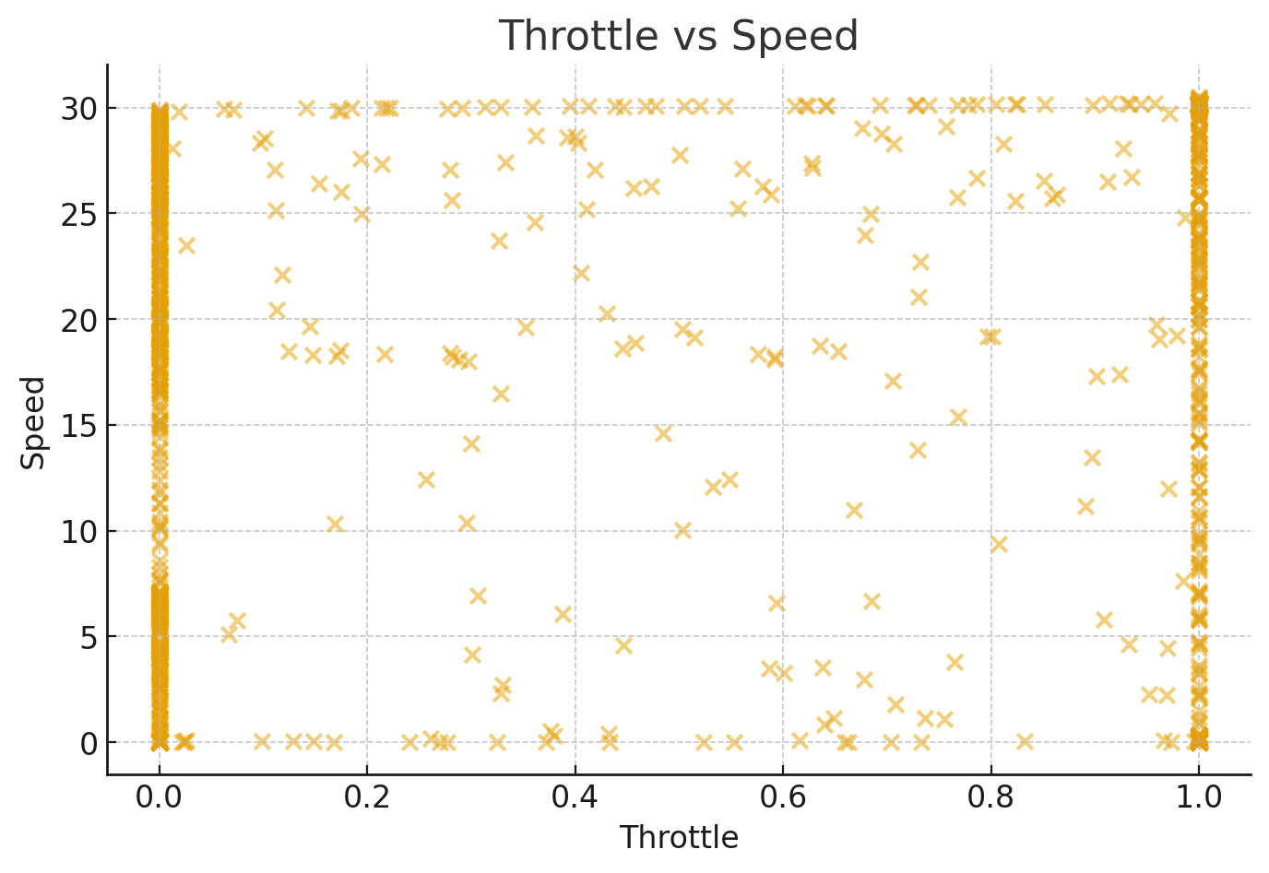
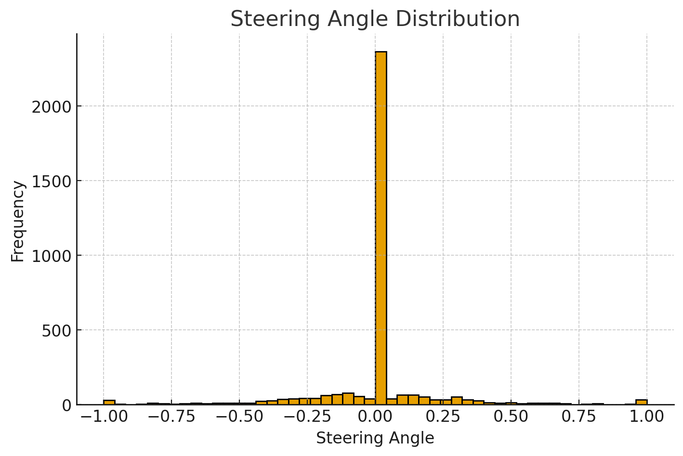
Screenshot of Output:

Slide 8
Conclusion:
Autonomous Control System for Electric Vehicles — successfully demonstrates how deep learning can enable intelligent and safe driving.
We developed a behavioral cloning model that learns from human driving data and makes real-time driving decisions like steering and throttle control.
The system performed effectively in the simulator, showing smooth navigation and reduced human error.
This project proves that AI-powered autonomous control can enhance the safety, efficiency, and sustainability of electric vehicles.
In the future, the system can be improved by adding features like lane detection, obstacle avoidance, and traffic sign recognition to make it more reliable for real-world use.”

